Slide 1
Amazing Seeds!
My name is: *********
My favourite plant is: **********

Slide 2
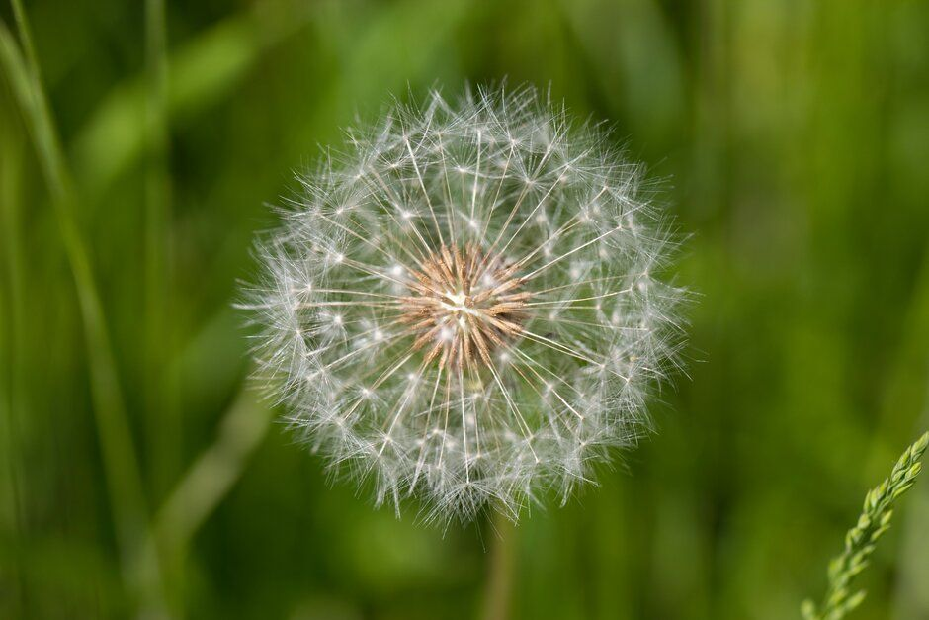
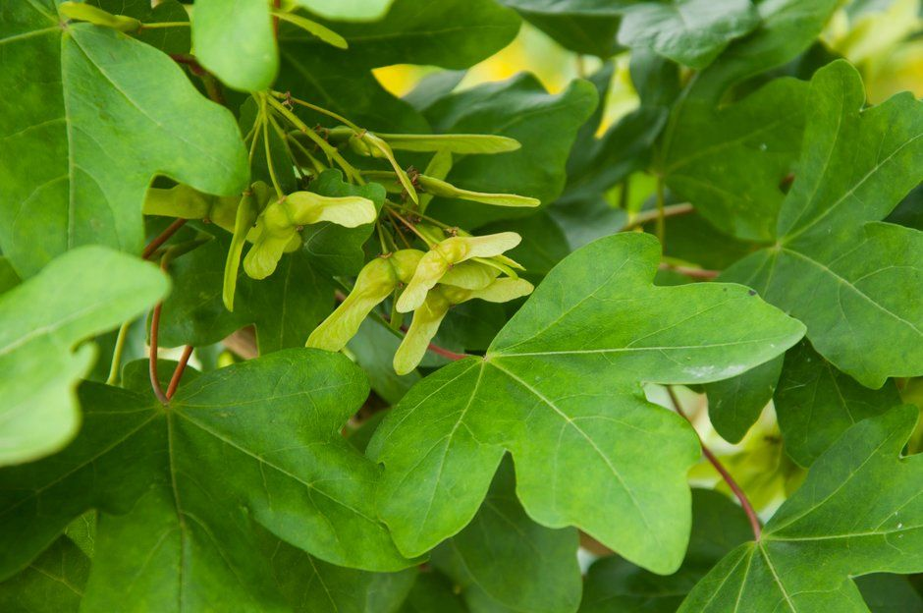
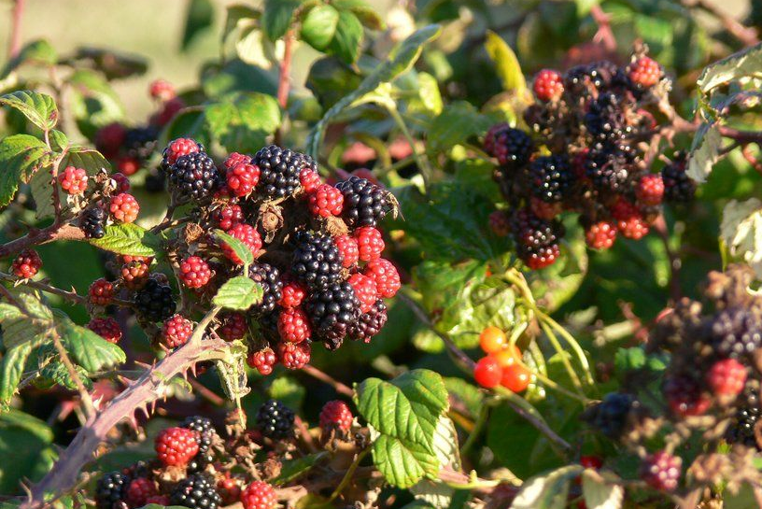
1.1
Notes:
Sheet 1.1 Lets look at seeds

Slide 3
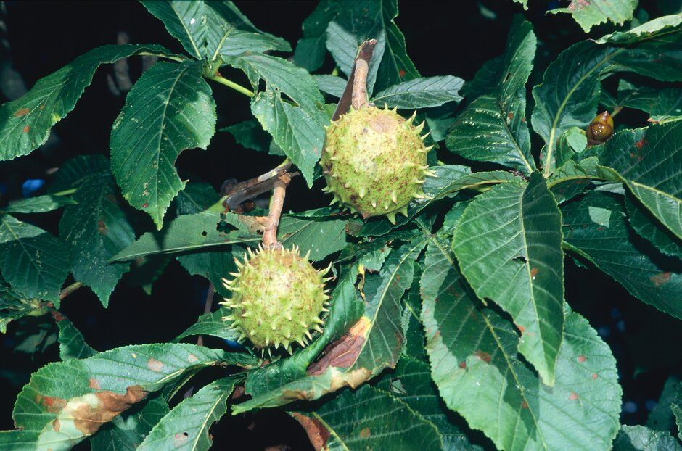
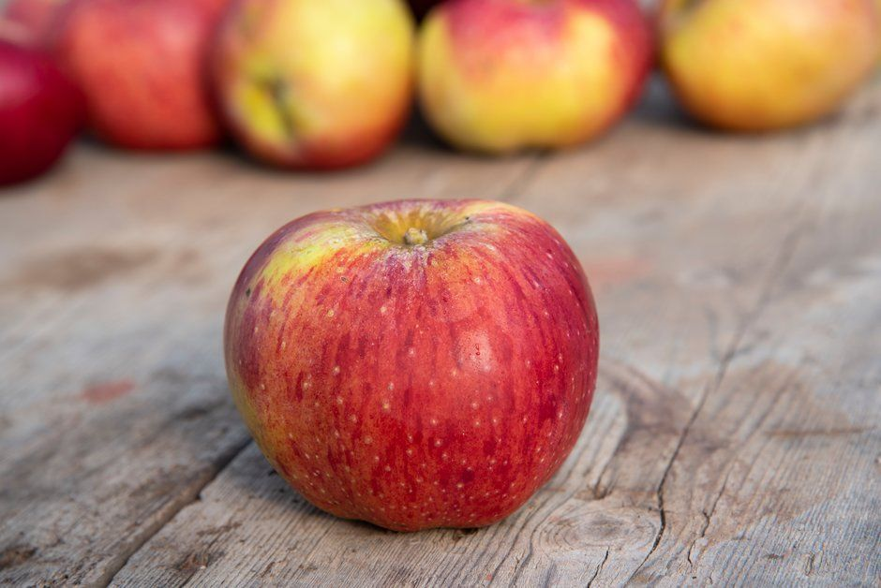
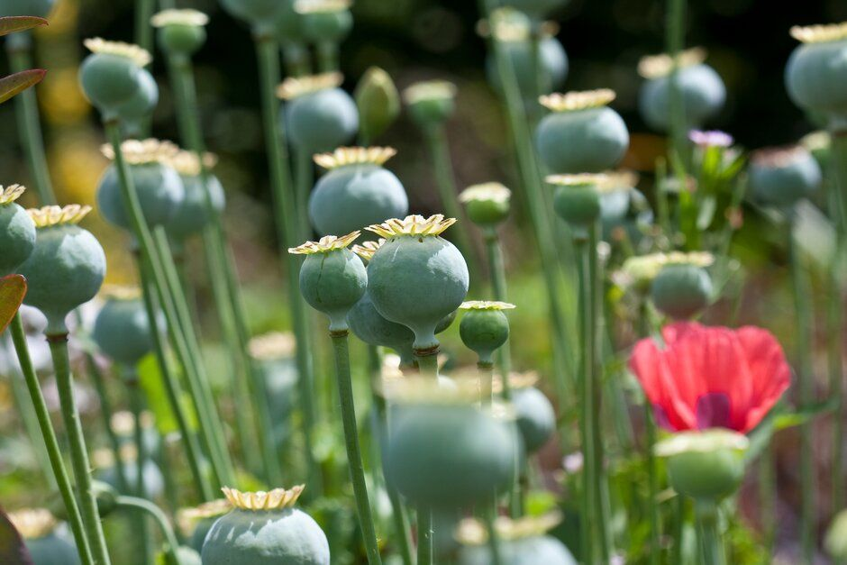
1.1
Notes:
Sheet 1.1 Lets look at seeds

Slide 4
1.2 Dead or alive?
Breathe
Move
Grow
Feel
Eat
Have babies
Created by Abd Majd from Noun Project
Notes:
Sheet 1.2 Dead or alive?

Slide 5
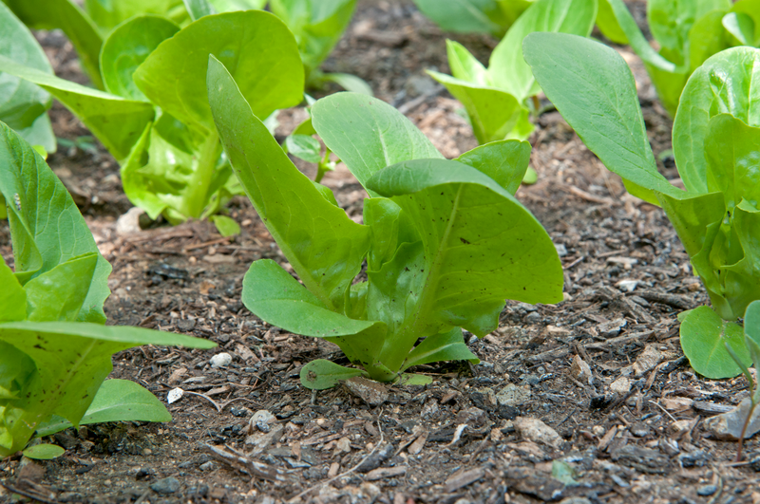
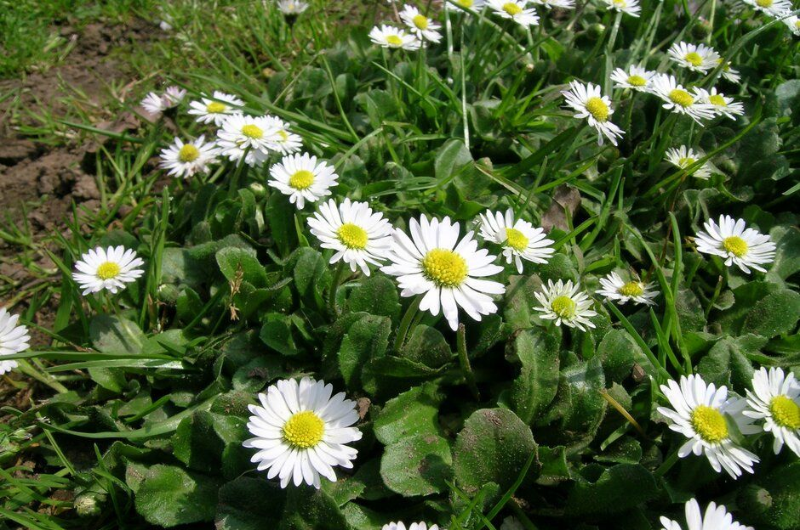
1.2 Are plants alive?
Notes:
Sheet 1.2 Dead or alive?

Slide 6
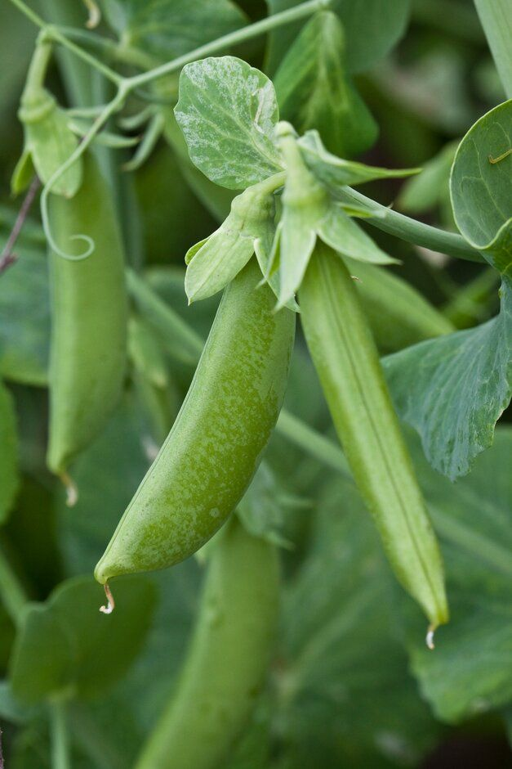
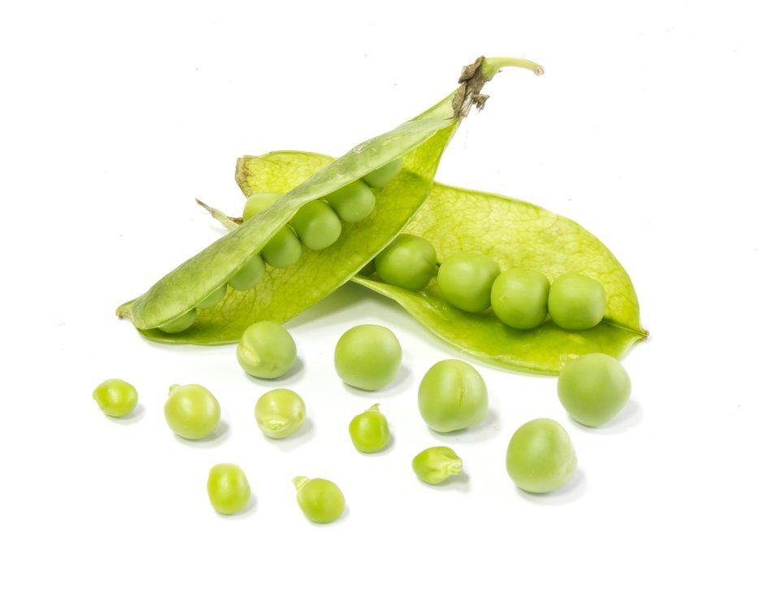
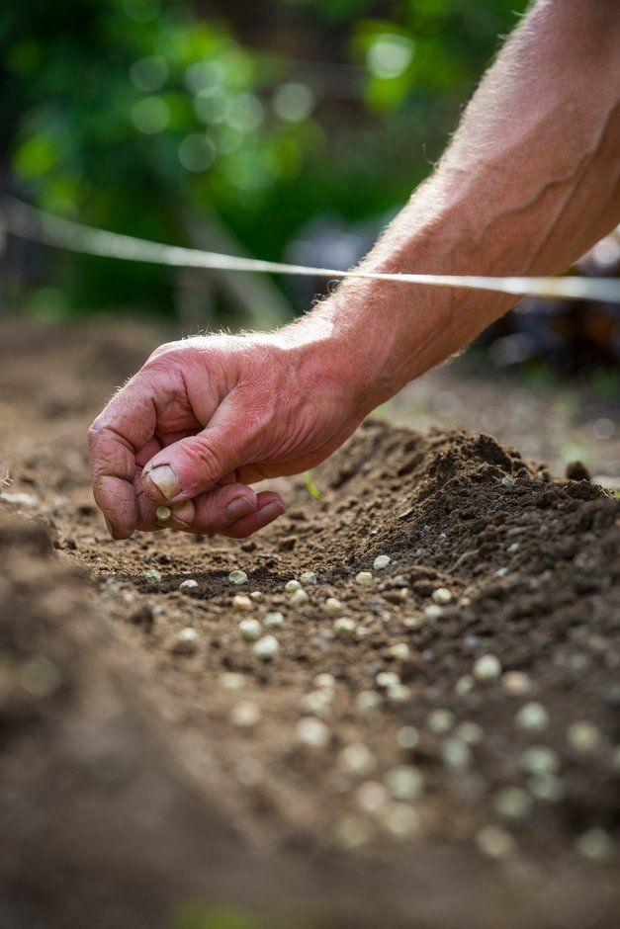
1.2 What’s inside a seed?
Notes:
Sheet 1.2 Dead or alive?

Slide 7
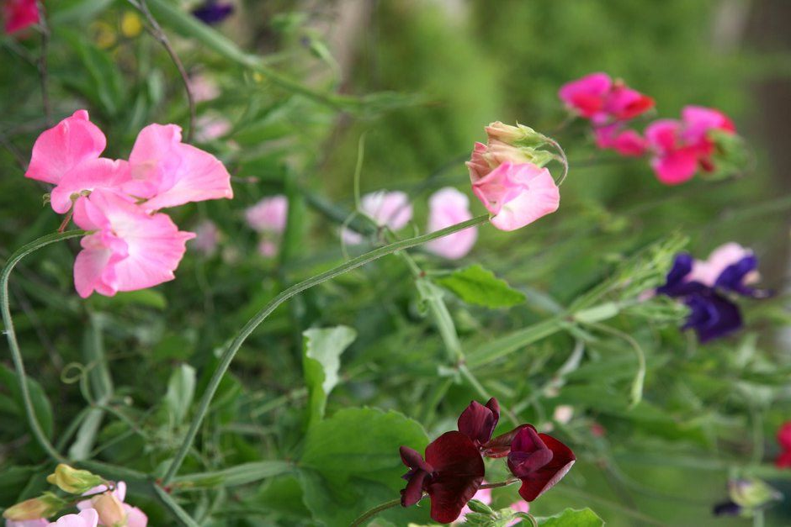
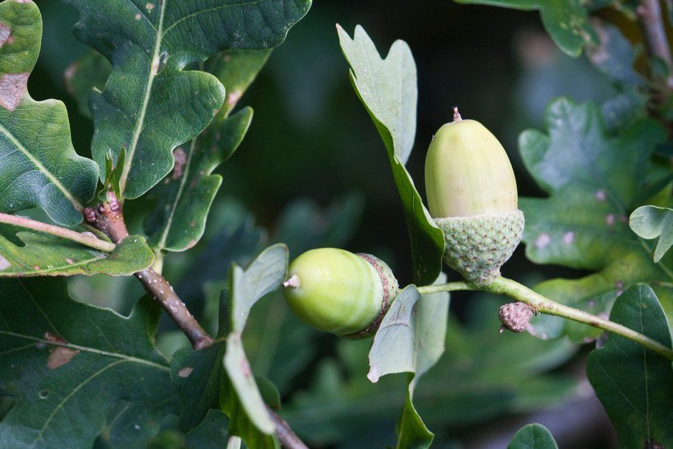
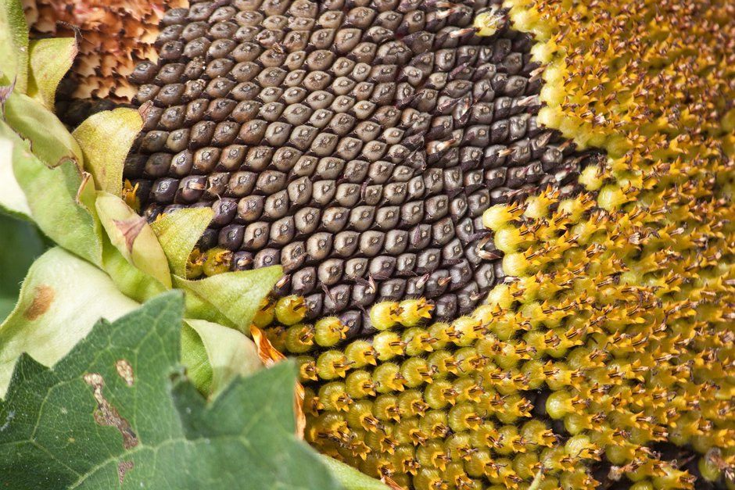
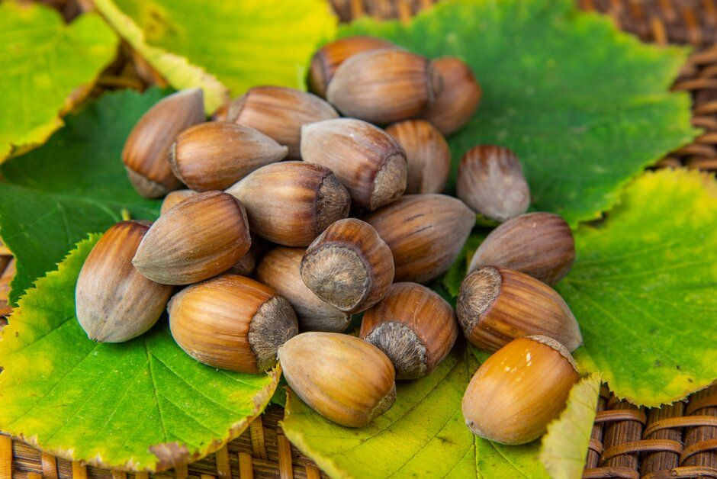
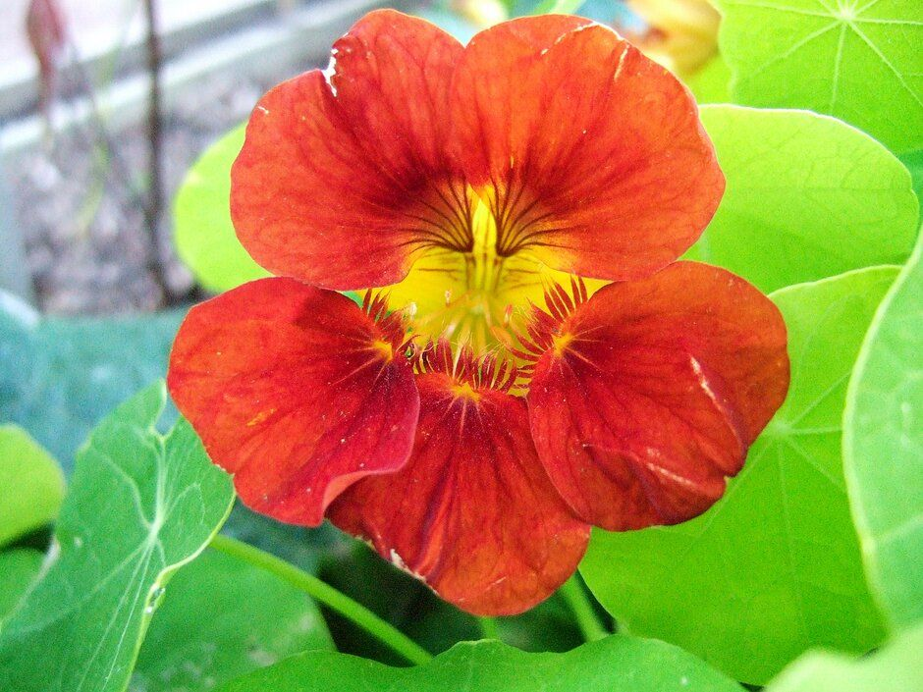
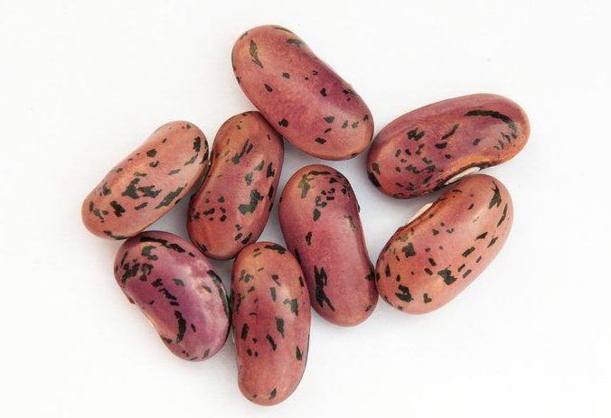
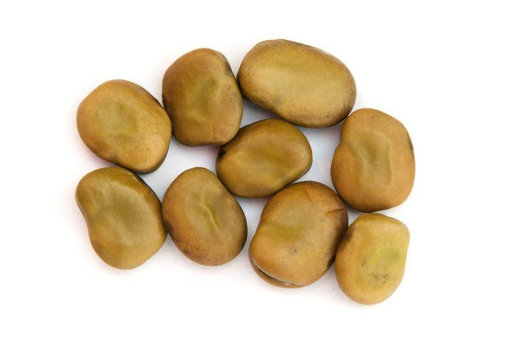
1.2 Are seeds alive?
Sweet peas, nasturtiums and sunflowers can grow from seeds that sleep in the soil all through the cold winter months.
Notes:
Sheet 1.2 Dead or alive?

Slide 8
2.0 Seeds leave home in different ways
Notes:
Sheet 2.0 Seeds leave home in different ways

Slide 9
Notes:
Sheet 2.0 Seeds leave home in different ways
Maple seeds falling (7Arleth7)
https://www.youtube.com/watch?app=desktop&v=5-7GIrn99mQ

Slide 10
2.2 What have we found out?
1. Seeds often have life inside them
2. Sometimes plants make seeds that can survive until the season is good for growing
3. Some plants move their seeds away from them with a helicopter wing
Notes:
Sheet 2.2 What have we found out?

Slide 11
2.3 What can we find out next?
Some seeds are exploded out of their seed cases and fired away from the plant!
Watch the video, what is happening? What sort of plant is it?
Notes:
(Give Amazing Seeds follow up for teachers to class teacher)

Slide 12
Notes:
Sweet Pea Pod exploding (Sally Peyou)
https://www.youtube.com/watch?v=IuaZHXQXeJc

Slide 13
CHALLENGE:
Can you create a device to fire seeds a long distance?

Slide 14
@rhsgrassroots
@rhsschoolgardening
@RHSSchools
https://schoolgardening.rhs.org.uk/home

