Slide 1
Hello!
My name is

Slide 2
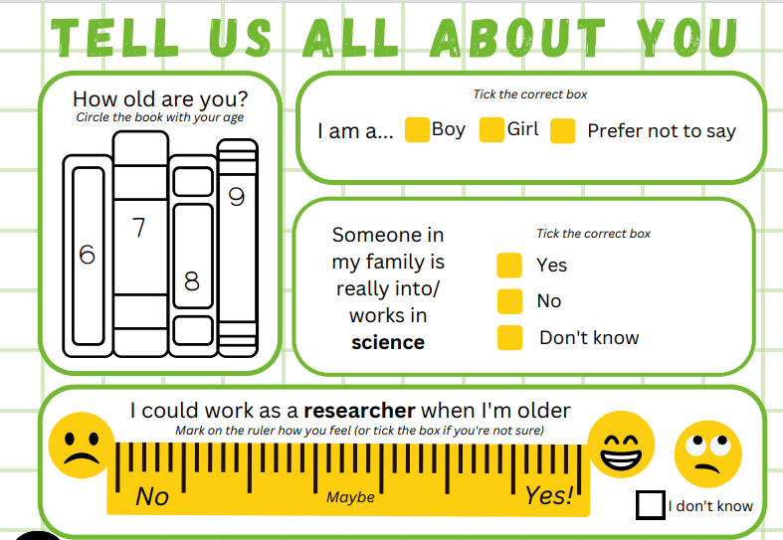

Slide 3
Hands up…
Who likes…

Slide 4
Observing
what can YOU see in the pictures that might tell you what I do?

Slide 6
My Research
Next few SlideS to be adapted FOR Explaining your job

Slide 9
Questioning
Write down 2 open questions
Use these question starters: what, how, which, when, why

Slide 10
Recording
What do you know now?

Slide 11
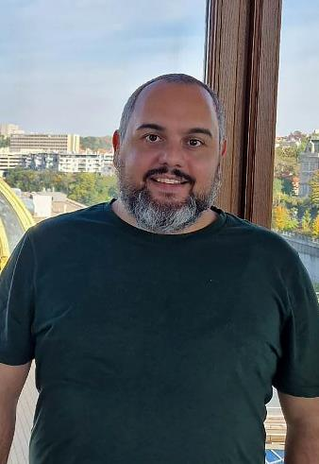
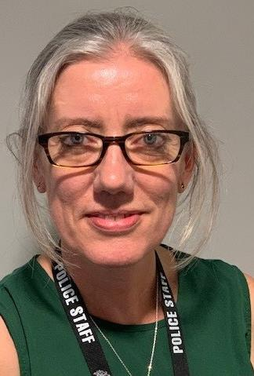
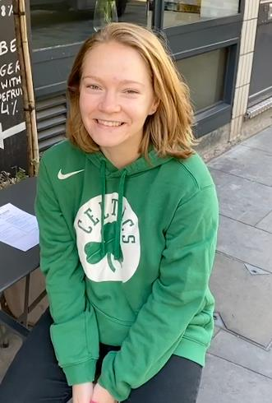
Luca
Lisa
Mackenzie
A - Space
B – Computers
C - Crime

Slide 12
Luca
Lisa
Mackenzie
A - Space
D - Crime
C – Computers

Slide 13
Creativity
what would you like to research that might be important OR help other people?

Slide 15
Observing
Recording
Asking questions
Thinking creatively

Slide 16
Thank you!

